Slide 1

It’s All About Thinking, Write?
Council of the Great City Schools
Albuquerque, New Mexico October 29 and 30, 2013
Day Two

Slide 2
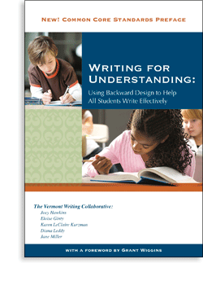
Presented by the
Vermont Writing Collaborative
Joey Hawkins
joeylornell@gmail.com
Kristin Armstrong
kra888@hotmail.com

Slide 3
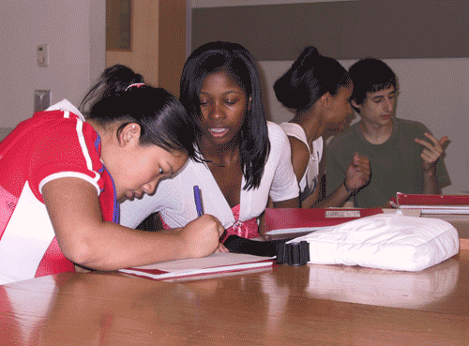
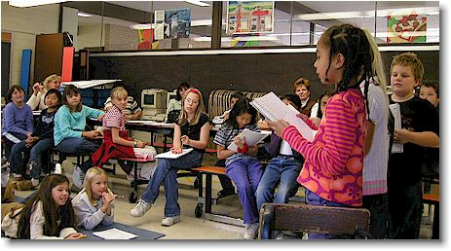
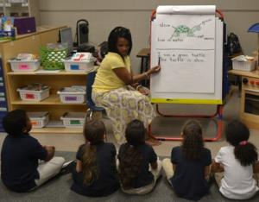
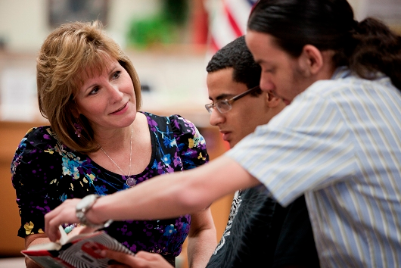
The Big Idea
When teachers
• plan instruction carefully,
• emphasize building understanding, and
• help students to talk about that understanding,
everyone benefits

Slide 4
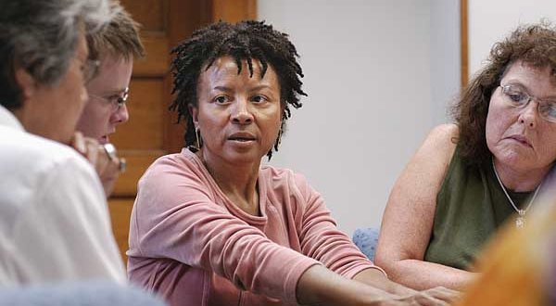
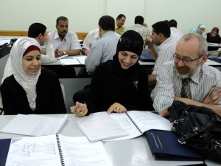
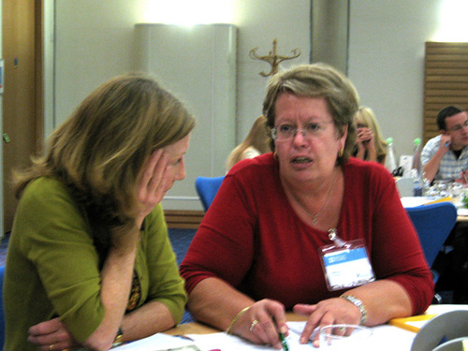
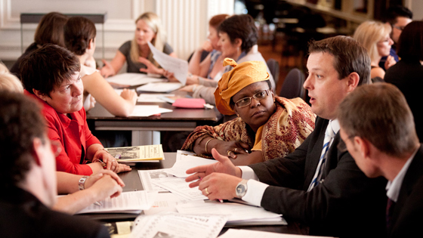
A Shared Reading Experience

Slide 5
“Knowing, Thinking, and Writing”
Take a few moments of thoughtful solitude to read the text
As you read, mark places that are worth discussing
In a group of 3-4, take turns discussing the spots you marked

Slide 6
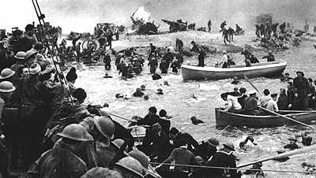
A Closer Look: The Role of a Model in Helping Kids Write Effectively
“The Long Night of the Little Boats”

Slide 7
The Long Night of the Little Boats
Big Idea / Central Idea
Powerful forces – technology, geography, values/ideas, economics, and desire for power – come together to create human history
Focusing Question for Writing
How did the forces of history come together to create the events at Dunkirk in 1940?

Slide 8
Models Can Help
The Great Breakdown of 1995
Human history can be complicated. When we look at any big historical event, we know that it has many causes. Great forces are at work, often all at the same time. The same can be true even of small, more personal events.
It was the fall of 1995. Sarah, aged 23, had just moved to Long Island, New York to go to graduate school. Graduate classes are often held at night so that students can work during the day, so on this particular fall date Sarah was returning to her apartment by way of the Long Island Expressway around ten o’clock at night. The Long Island Expressway is always a busy place. No matter what time of day or night one drives on it, there is always heavy traffic, and it is always speeding right along. As Sarah was whizzing down the highway , she suddenly heard a loud CLUNKETYCLUNK-CLUNK-CLUNK. At the same time, she felt the car lurch to the side. When she pulled over and got out to look at the car, she realized she had a flat tire. It was a frightening moment for her, to say the least. As it happened, however, luck was with her. Even before a police car could stop to help, a motorist stopped to help. The motorist could not speak English, but he could see what was wrong with the car. Within moments he had the flat tire off; within ten minutes, the spare tire was on and the car was ready. When Sarah tried to pay him, he simply smiled and waved, then got in his car and drove off.
In this seemingly simple event, we can see that broad forces of human history came together to make it happen. Three of the most striking are technology, economics, and ideas/values.
First, technology played a large part in Sarah’s flat tire experience. She, like all other drivers, was completely dependent on the tires of her car. Tires are an amazing technological invention. Scientists have learned, in the last 150 years or so, to make better and better tires out of rubber and other materials. Tires can take an amazing amount of abuse. Sarah had already driven 30,000 miles on her car’s tires, and they had never failed her. However, they failed her that night.
A model that is similar to what the student will write gives the student a sense of where he is going – both in terms of overall structure, and in terms of what this kind of thinking can look like.
Read the model in your packet on pp. 41 and 42. . How could this be useful to students in writing about the little boats?

Slide 9



Common Core Literacy:
What are the key shifts in ELA?
1. Increasingly complex texts
3. Knowledge Base
2. Evidence matters
Notes:
NOTE: argument Powerpoint was used at this point, then returned to this Powerpoint

Slide 10

Genetically Modified Organisms: A Public Issue
An Integrated Common Core Unit for
High School Students

Slide 11
First, think about the “The GMO Dichotomy” piece that you just read.
Hmmm……what did the teacher do to make sure students were able to show their understanding of this issue in an argument essay?

Slide 12
Central Idea / Enduring Understanding
The issue of how to handle GMO’s is a complicated one
When creating an argument, one needs to think deeply and critically, and be willing to participate in a conversation, not just a debate.
Focusing Question for Writing
Should we pass a law requiring all foods containing GMO’s be labeled?

Slide 13
A Close Look At a Complex Text
“Persuasion As the Cure For Incivility”
by John Jenkins
Several decades ago, my predecessor as the president of the University of Notre Dame, the Rev. Theodore M. Hesburgh, was presented with a dilemma. A Jewish student, after repeated hazing by some kids in his dorm, had left campus and gone home. After thinking it over, Father Hesburgh summoned the perpetrators. "Pack your bags," he told them. "Go find your friend. Either you persuade him to come back to Notre Dame, or you don't come back."
The approach worked for everyone concerned, and it may offer an idea for easing the incivility that marks much public discourse and leads to political stalemate. We need to try harder to persuade one another—to try to get people to change their minds.
There isn't nearly enough persuasion going on in America today, and there was too little, in the view of many citizens, in the past presidential campaign. A postelection Pew poll found that the 2012 campaign was a "frustrating experience" for many voters: 68% said there was more "negative campaigning and mudslinging," with less discussion of issues….

Slide 14
What Makes Text Complex?
Meaning
Layers of meaning
Structure
Text features
Knowledge
Background
Language
Vocabulary
Purpose
Concept complexity
Genre
Organization
Experiences
Sentence length and structure
Figurative language
Regional/historical usage (dialects)

Slide 15
Text Complexity in “Persuasion”
Meaning
According to P#3, what made the 2012 Presidential campaign a frustrating experience for many voters?
Structure
In P#5, the little word “but” is very important. What contrast is the author setting up with the use of this word?
Knowledge
In the game of chess, a “stalemate” happens when neither side can make a move and nobody can win. What do you think the term “political stalemate” might mean?
Language
What do you think the phrase “mutual animosity” means?

Slide 16
1 Several decades ago, my predecessor as the president of the University of Notre Dame, the Rev. Theodore M. Hesburgh, was presented with a dilemma. A Jewish student, after repeated hazing by some kids in his dorm, had left campus and gone home. After thinking it over, Father Hesburgh summoned the perpetrators. "Pack your bags," he told them. "Go find your friend. Either you persuade him to come back to Notre Dame, or you don't come back.”
2 The approach worked for everyone concerned, and it may offer an idea for easing the incivility that marks much public discourse and leads to political stalemate. We need to try harder to persuade one another—to try to get people to change their minds.
3 There isn't nearly enough persuasion going on in America today, and there was too little, in the view of many citizens, in the past presidential campaign. A postelection Pew poll found that the 2012 campaign was a "frustrating experience" for many voters: 68% said there was more "negative campaigning and mudslinging," with less discussion of issues.
4 The recent fiscal-cliff negotiations might have ended in a budget deal, but the rhetoric during the wrangling was hardly of the persuasive variety.
5 That is likely because much of the election campaigning and much of the budget discussion wasn't designed to change anyone's mind, but instead to encourage people to believe more deeply what they already believed—not about policies, for the most part, but about the villainy of the other side.
Read the rest of the text, and discuss the text-dependent questions with your partner
1. Now that you have read the whole article once, what do you think the title of this article means?
2. Look carefully at the incident described in P#1. What actually happened here? What is the author implying about the purpose of persuasion by beginning with this anecdote?
3. In P#2, what do you think the term “public discourse” means?
In the game of chess, a “stalemate” happens when neither side can make a move – so nobody can win. What do you think the term “political stalemate” might mean?
4. In P#3, what does “frustrating experience” mean?
According to P#3, what made the 2012 presidential campaign a “frustrating experience” for many voters?
5. In P#4, the author refers to “recent fiscal-cliff negotiations”. What were these? Discuss with your teacher and summarize in one sentence below.
6. In P#5, the little word “but” is very important. What contrast is the author setting up with the use of this word?
THINK! How does what you have read so far help you to define “incivility”?

Slide 17
What else did the teacher do to help build knowledge and understanding?
Making a Case
Persuasion is an art. The following list includes tools an author might use to make a case. The tools selected for a particular piece will depend on the author’s anticipated audience, the genre of text, and the style of the writer.
Aristotle’s Modes of Persuasion in Rhetoric
Rhetoric (n) - the art of speaking or writing effectively (Webster's Definition)
logos
ethos
pathos
Basic Elements of a Text
diction
syntax
text structure
Persuasive Strategies
fact
example
scenario
anecdote
analogy
The New York Times
September 14, 2012
Uneasy Allies in the Grocery Aisle
By STEPHANIE STROM
Giant bioengineering companies like Monsanto and DuPont are spending millions of dollars to fight a California ballot initiative aimed at requiring the labeling of genetically modified foods. That surprises no one, least of all the proponents of the law, which if approved by voters would become the first of its kind in the nation.
But the companies behind some of the biggest organic brands in the country -- Kashi, Cascadian Farm, Horizon Organic -- also have joined the antilabeling effort, adding millions of dollars to defeat the initiative, known as Proposition 37.
Genetically Engineered Foods Threaten to
Contaminate Organic Food
Genetically Engineered Foods, 2012
Paula Crossfield is the co-founder and managing editor of Civil Eats, a food policy site that promotes
Sustainability….
Recent decisions by the US Department of Agriculture to allow genetically modified (GM) sugar
beets and alfalfa increase the risk that organic foods will be contaminated by GM material. Despite
proposals to protect organic crops from GM seeds, it is impossible for these two farming methods
to co-exist because there are many ways for contamination to occur. Further, since GM seeds are
patented by biotechnology companies, these companies have the legal right to sue organic
farmers whose crops become contaminated by GM traits. This regulatory stance places the
burden on organic farmers to test for and prevent contamination, resulting in higher prices for
organic food, and threatening the future of organic farming.
Last Friday [February 4, 2011], the USDA [US Department of Agriculture] announced the partial
deregulation of genetically modified sugar beets, defying a court order to complete an Environmental
Impact Statement (EIS) in advance of a decision. This move follows on the heels of the full deregulation
late last month of genetically modified (GM) alfalfa, the fourth most common row crop in the United.
Battle Brewing Over Labeling of Genetically Modified Food
GREAT BARRINGTON, Mass. — On a recent sunny morning at the Big Y grocery here, Cynthia LaPier parked her cart in the cereal aisle. With a glance over her shoulder and a quick check of the ingredients, she plastered several boxes with hand-designed stickers from a roll in her purse. “Warning,” they read. “May Contain GMO’s (Genetically Modified Organisms).”
For more than a decade, almost all processed foods in the United States — cereals, snack foods, salad dressings — have contained ingredients from plants whose DNA was manipulated in a laboratory.

Slide 18
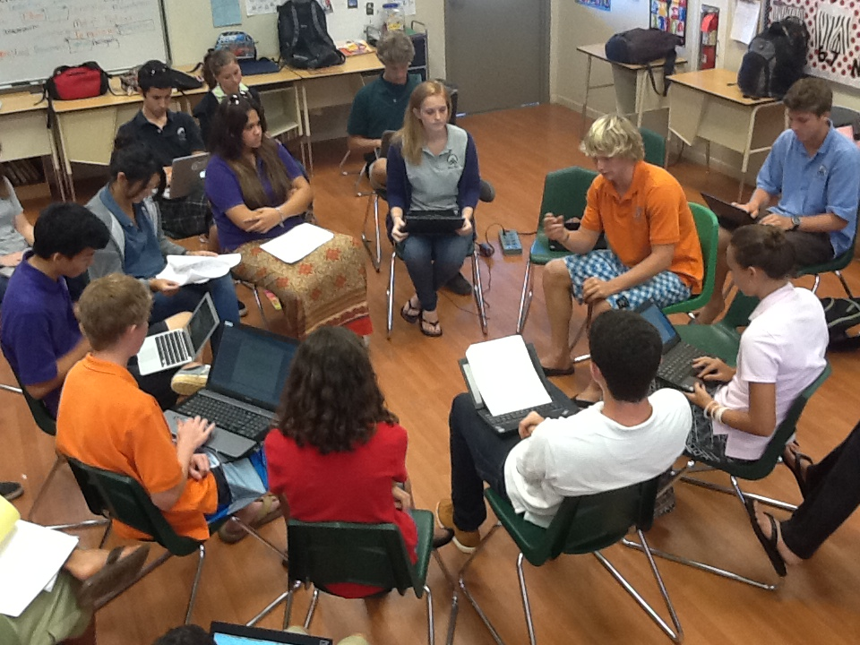
And what ELSE did the teacher do to help build knowledge and understanding?
Socratic Seminar
Well-prepared with notes, and a
disposition towards thinking and
listening, students formally discuss
the issue of GMO’s and whether or
not there should be a law requiring
that they be labeled in food.

Slide 19
Remember where we’re headed with this…
Focusing Question for Writing
Should we pass a law requiring all foods containing GMO’s to be labeled?
Focus Statement / Claim
We should / should not pass a law requiring all foods containing GMO’s to be labelled.

Slide 20
Let Me Think About That: Considering Both Sides Before Formulating a Claim in Argument Writing
Yes, the law about GMO labeling should pass No, the law about GMO labeling should not pass
YES: Reason #1 | Evidence / reasoning | NO: Reason #1 | Evidence / reasoning
Hmm…..now that I’ve thought carefully about it, my claim is……………….
Notes:
Discuss with a partner – in argument writing, what’s so important about a final step like this before writing?

Slide 21

What is “In Common”?
A collection of annotated student samples K-12.
On Demand Writing
Range of Writing

Slide 22

Finding In Common www.achievethecore.org

Slide 23

Click “Student Writing Samples”

Slide 24
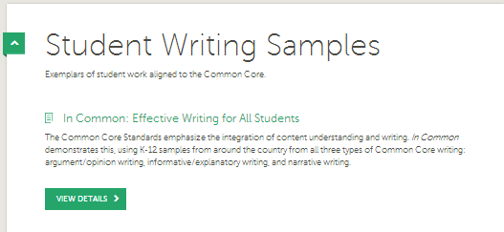
In Common, VIEW DETAILS

Slide 25
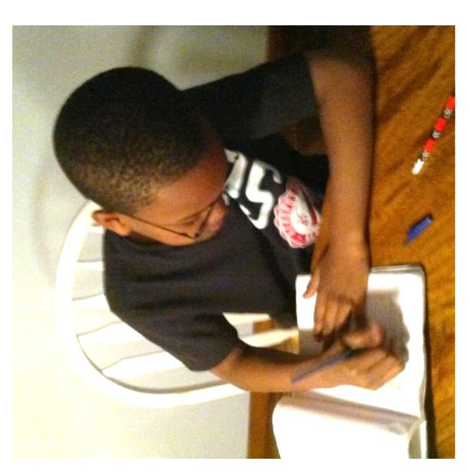
On Demand Writing
Uniform Prompts
Three Writing Types K-12
Text Based – 2-3 class sessions
Similar Prompts K-5 and 6-12
Purpose:
Highlight the developmental progressions in the standards
Build an understanding of grade specific expectations

Slide 26
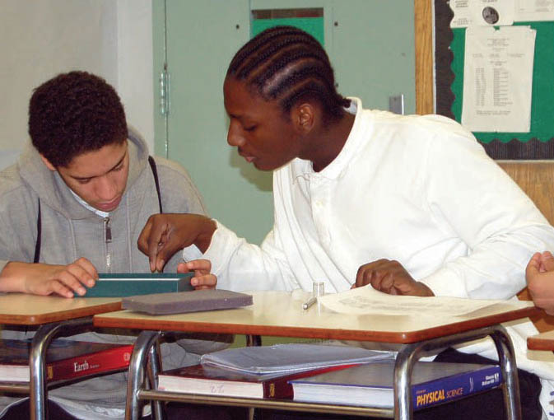
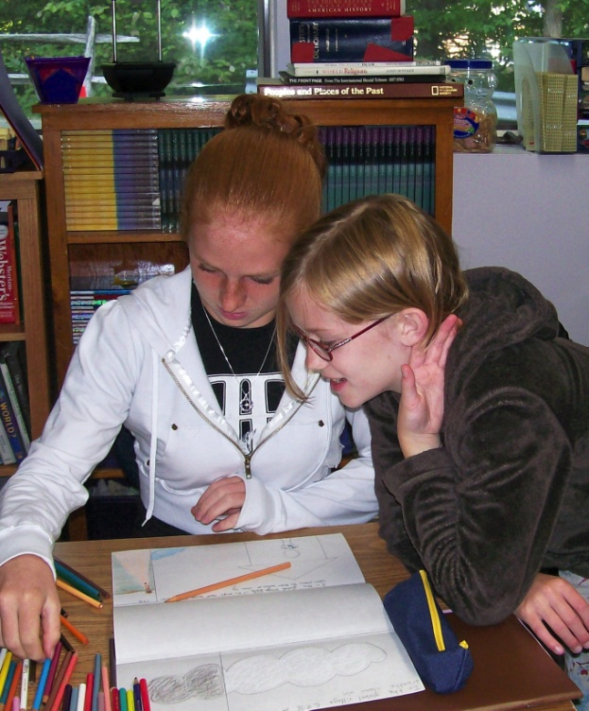
What can strong student Common Core work, written independently from complex text, look like?
Read these texts, all
written by students in grades 2 – 12
How do they reflect the
Common Core
informative writing standards?
How can you see deep
understanding and analysis in these pieces?

Slide 27
Your Turn!
Work with a partner to figure out how you might use one of these texts with students
What Focusing Question for writing might you use?
How would you design close reading to build knowledge and understanding for writing?

Slide 28
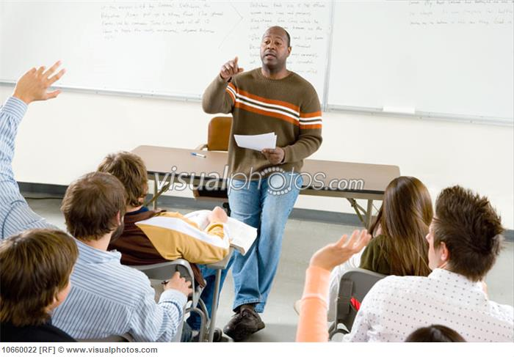
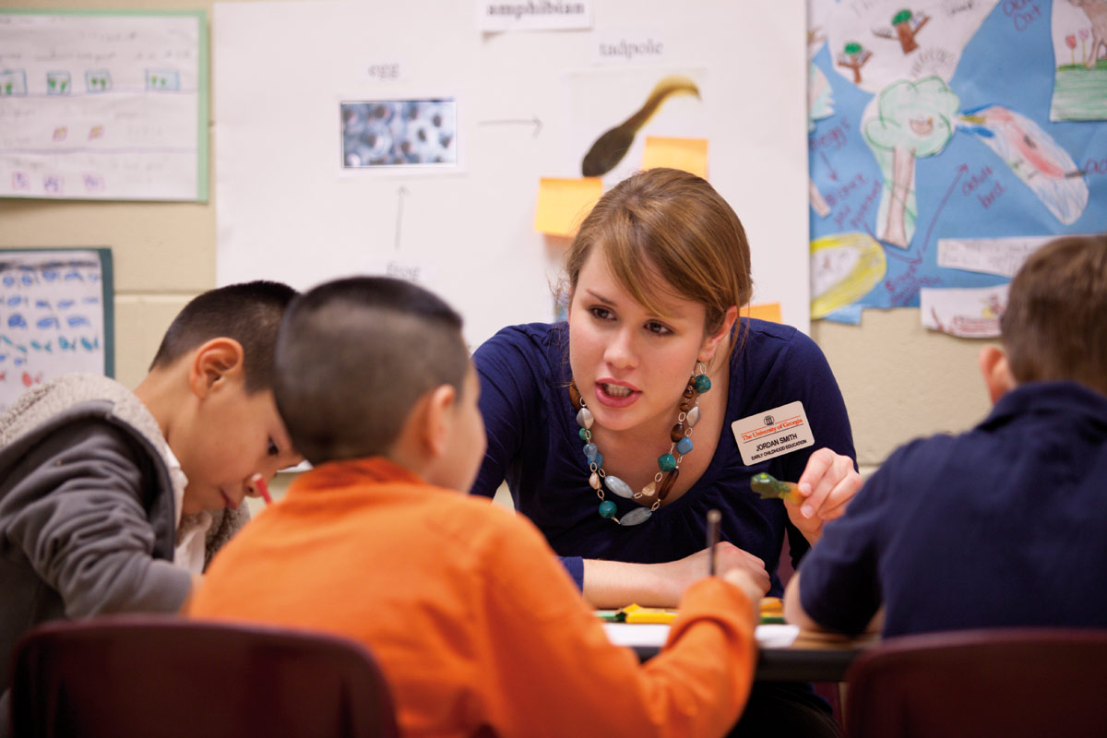
Take a moment to reflect….
What kinds of supports will teachers need to be able to do this work successfully with students?

Slide 29


Presenters’ Names
www.vermontwritingcollaborative.org
For more information, contact:
Diana Leddy
Educational Consultant
everywritevt@aol.com
Joey Hawkins
Educational Consultant
joeylornell@gmail.com
Kristin Armstrong
ELL teacher
kra888@hotmail.com

Slide 30
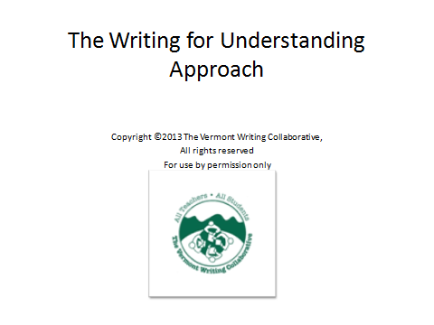
It’s All About Thinking, Write?
Day Two
Copyright © 2013 Joey Hawkins, Vermont Writing Collaborative
All rights reserved
For use by permission only

